Slide 1

Navigating the Future of Work
Emma Chambless
July 2025
Notes:
Welcome to my project presentation this evening!

Slide 2
Overview
Notes:
Tell the story of my recent experience and observations.

Slide 3
Key Research Findings
AI & Automation’s Transformative Impact
Evolving Job Roles & Skills
Organizational Shifts & Well-being
The Human Element & WOP
Societal & Policy Implications
Notes:
Let’s jump right in! I found 5 key points in my research
AI’s transformative impact
Roles and skills evolution
Org shifts & well-being
The human element, the (WOP) work and organizational psychology
The implications of AI on society and our policies.

Slide 4
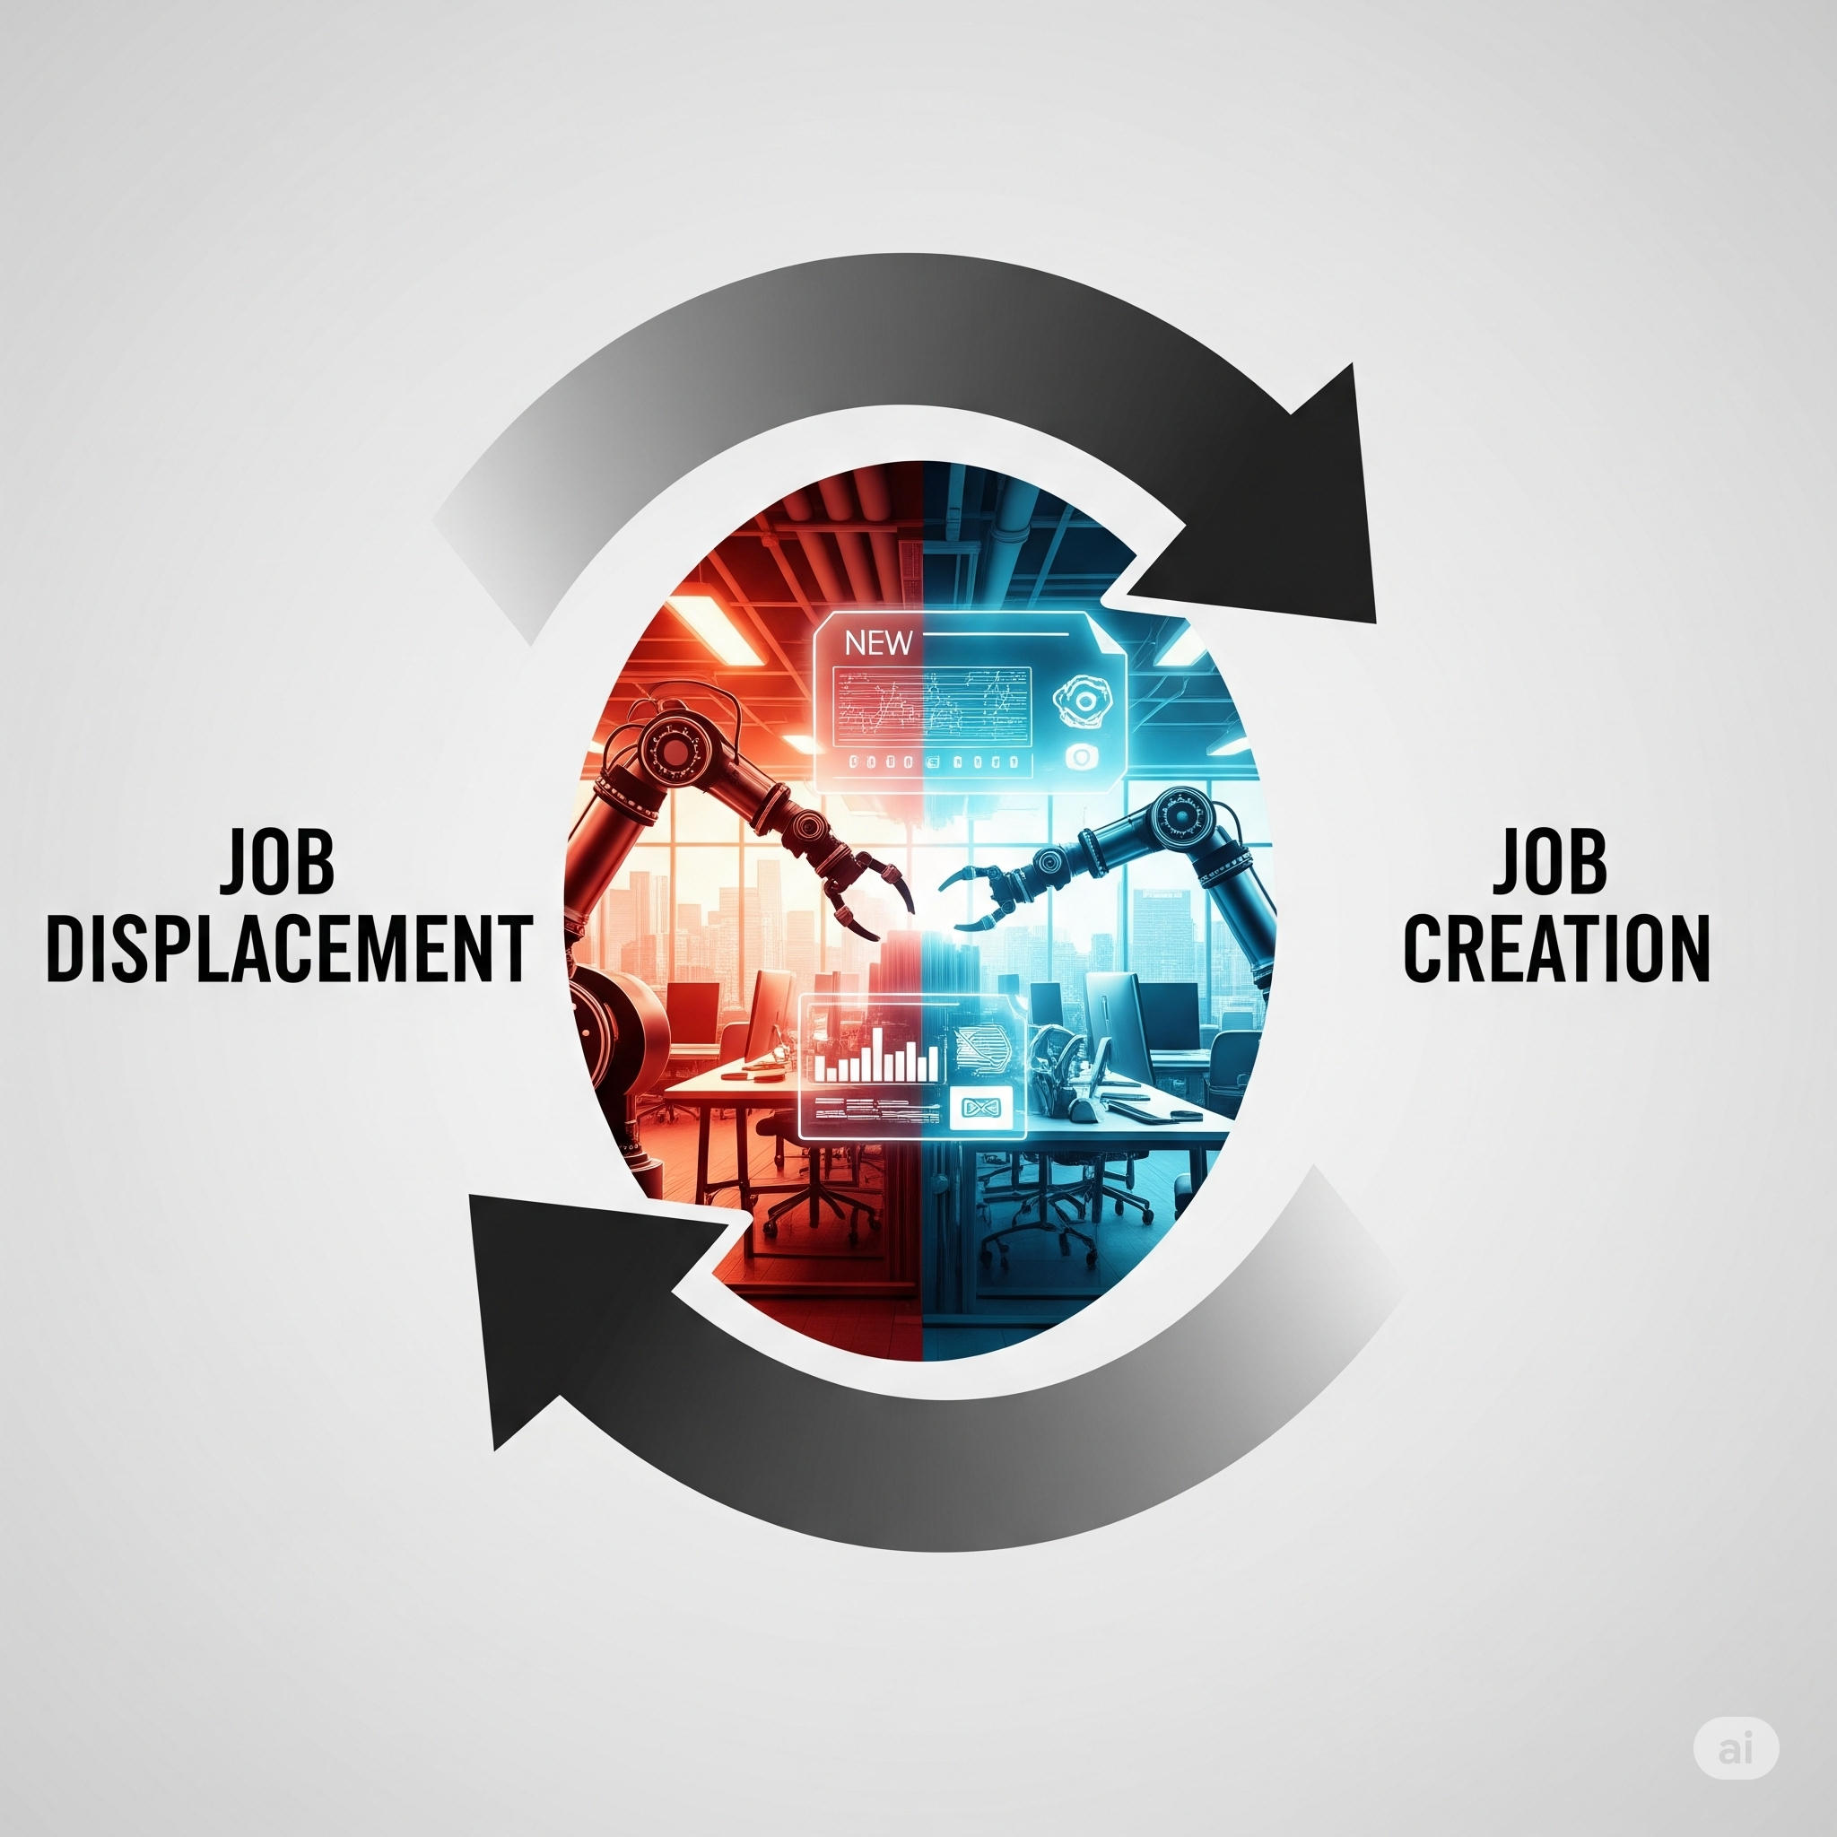
#1: The AI & Automation’s Transformative Impact
Fundamental Redefinition of Work
Almost All Jobs will change
Job Displacement & Creation
AI Exposure Challenges Perceptions
Notes:
We learned at NCWU (in a previous course) that AI and automation's impact is a dual market force: enabler and disruptor.
In that vein, my research supports a Fundamental Redefinition of Work: not just a shift, but one that can completely redefine how work is done.
Some research suggests "Almost All Jobs Will Change, “ emphasizing adaptation and job redesign.
World Economic Forum forecasts 22% of jobs impacted right now, a net increase of 7% over their previous reports
A 2022 Pew Research study found 19% of US workers are in "highly exposed" jobs, and that Exposure = Augmentation:
Those in highly exposed jobs (women, college-educated & higher income earners, we’ll talk about that more in a minute) are more likely to see AI as beneficial.

Slide 5
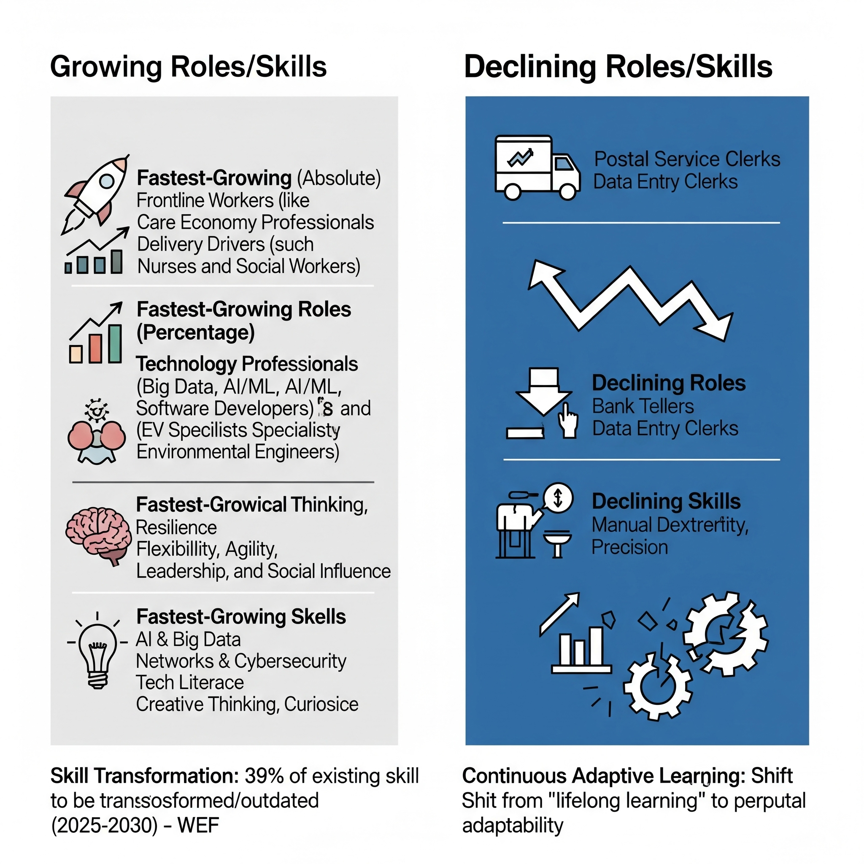
#2: Evolving Job Roles & Skill Needs
Notes:
Let’s talk about evolution/transformation
Declining Roles: Postal Service, Bank Tellers, Data Entry Clerks.
Declining Skills: Manual dexterity, endurance, precision.
The World Economic Forum reports that (between 2025-2030) 39% of existing skill sets will be transformed/outdated.
Forcing a Shift from "lifelong learning" to perpetual adaptability.
Fastest-Growing AI Roles (Absolute): Frontline (Farmworkers, Delivery Drivers), Care Economy (Nurses, Social Workers), Education.
Fastest-Growing AI Roles (Percentage): Technology (BD Analysts, Software Developers), Green/Energy Transition (EV Specialists, Environmental Engineers).
What do you think some of the growing and top skills might be?
ANSWERS:
Fastest-Growing Skills: AI, Big Data, Network & Cybersecurity, Tech Literacy, Creative Thinking, Curiosity.
Top Skills: Analytical Thinking, Resilience, Flexibility, Agility, Leadership, Social Influence.

Slide 6

#3: Organizational Shifts & Well-being
Notes:
Due to events like the COVID-19 pandemic and the influence of Gen Z, Hybrid work is a Strategic Imperative. To create work-life balance, job satisfaction, and access to top talent, companies must prioritize employee well-being and create a workforce culture with expectations for flexibility, inclusivity, and values-driven work.

Slide 7
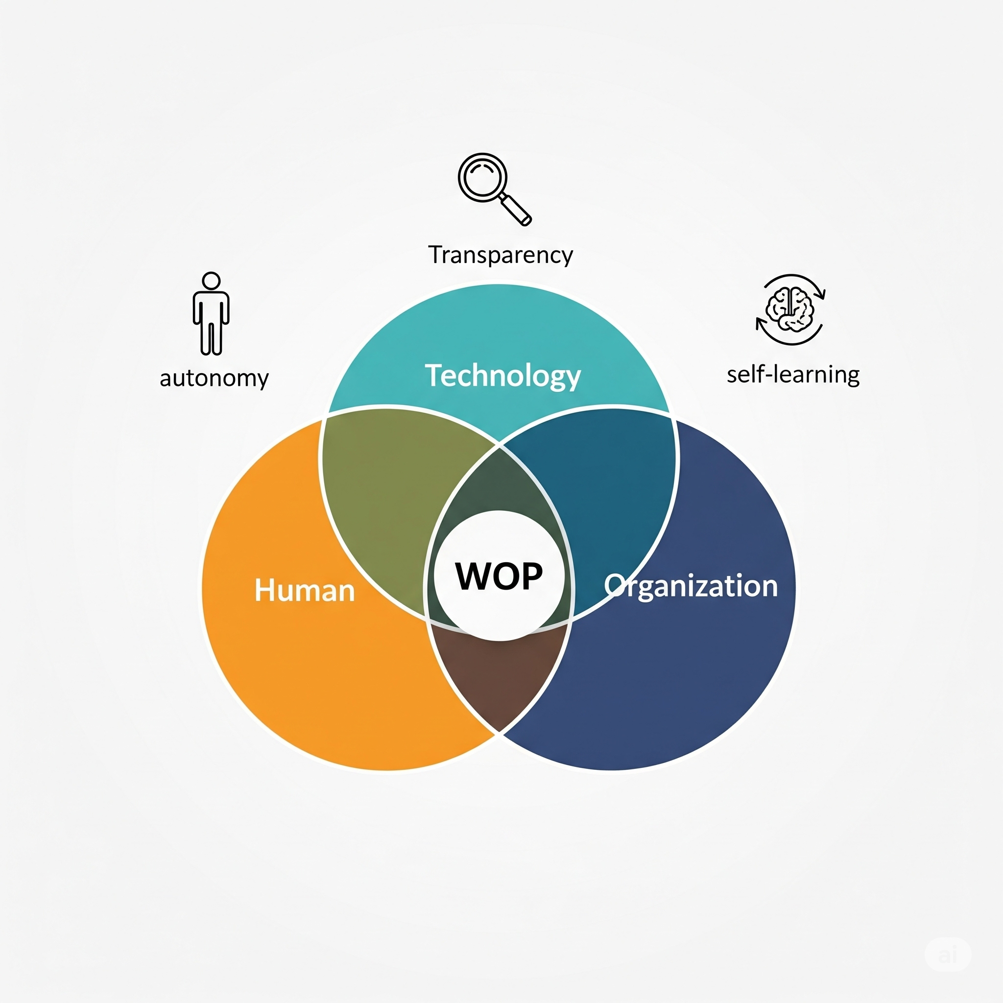
#4 The Human Element & WOP
Notes:
Work and Organizational Psychology is a field of study and practice that applies psychological principles and research methods to the workplace for improving productivity, job satisfaction, and overall organizational effectiveness. Think of people in this field as AI- Organizational Design (OD) practitioners/consultants…
WOP's Critical Role: WOP will offer perspectives on the human-technology interface, advocate for human-centered design, and address psychosocial implications.
Such as:
AI as "teammates," impacting user satisfaction, self-efficacy, and stress management.
Solving the "Black box" problem (what/how AI makes decisions), and/or the raised questions of oversight and responsibility.
And Improving Dynamic adaptation, altering the notions of uncertainty about reliability.
This is an area I am passionate about. As a strategic technology people leader, I am more than just a “manager”, “director” – How many people leaders are here? Show of hands? Then you know that psychology is part of our talent growth imperative! Creating psychological safety and incorporating inclusivity is something we work at for our teams and team members daily!

Slide 8
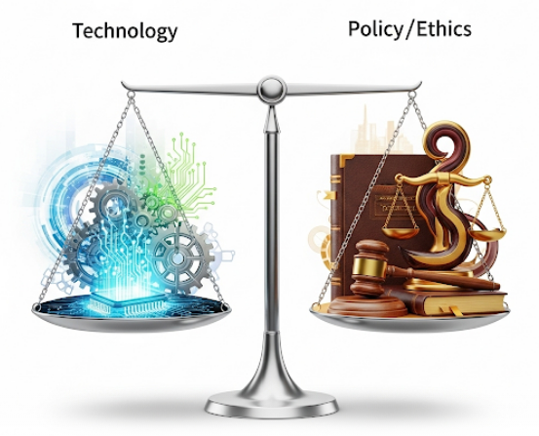
#5: Societal & Policy Implications
Notes:
There is a"Perception Gap“. A Divergence between public (low awareness/impact belief) and expert views on AI's impact. This is caused by what’s referred to as
Ethical Debt: Concerns about algorithmic bias, accountability for AI errors, which call for ethical AI development and transparent algorithms. (aka “Black Box”)
Additionally, there is Regulatory Lag: Rapid technological change vs. slow policy development, which drives a need for agile governance models. S
purring what WEF reports as Geoeconomic Fragmentation & Economic Uncertainty, those being the major drivers of labor market transformation.
Now that I’ve scrambled your brain, let’s shift gears…looking at the Future of Work more closely

Slide 9
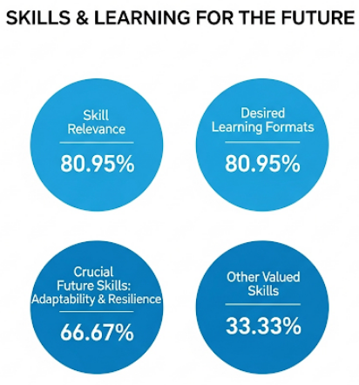
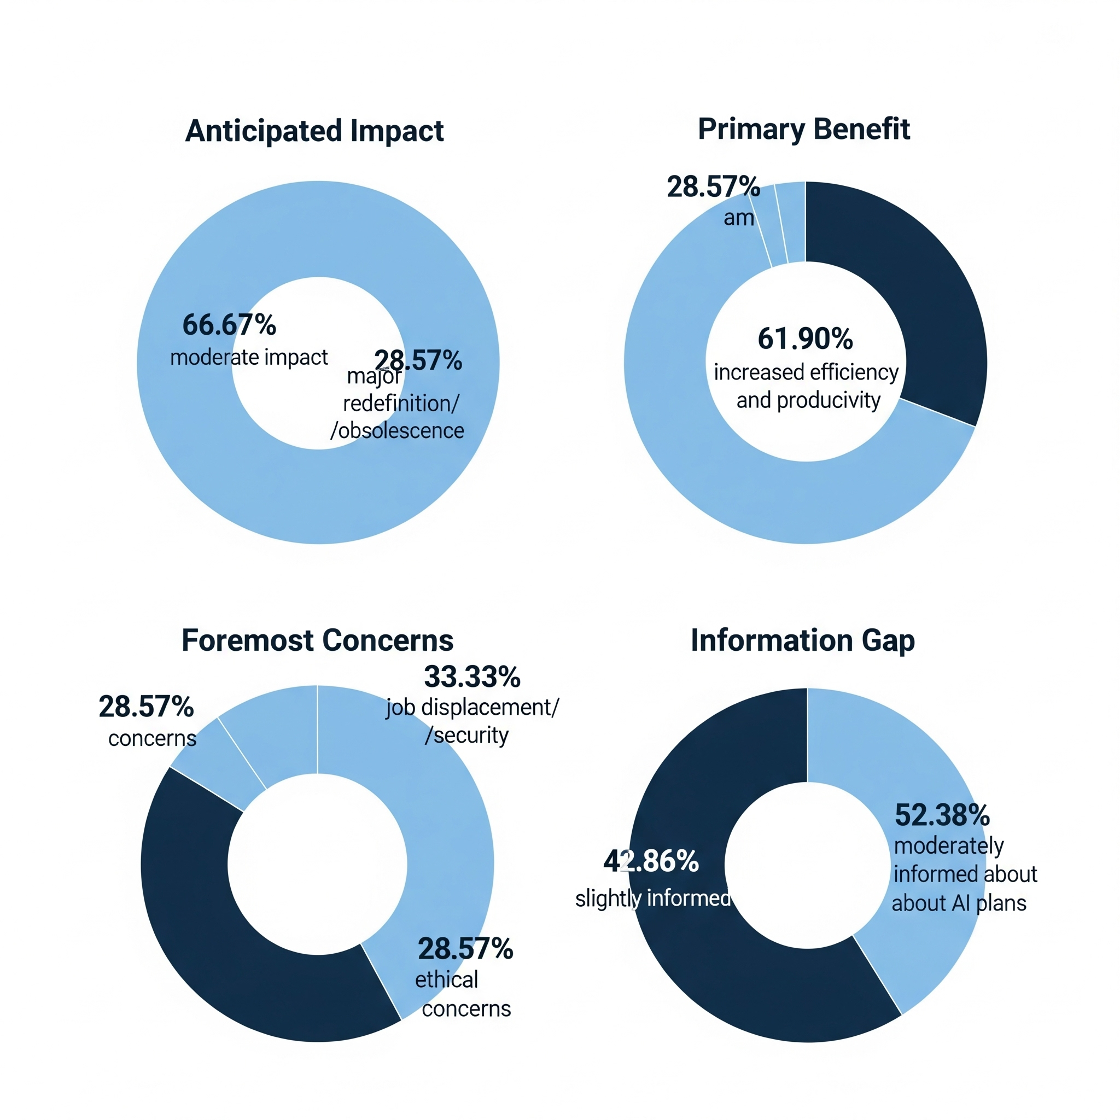
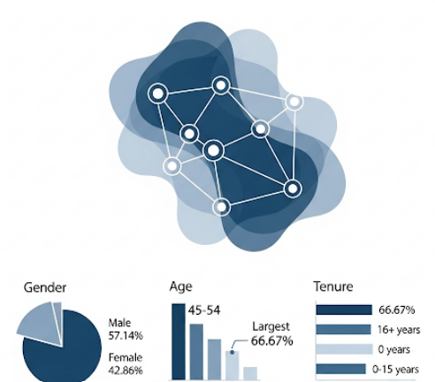
Survey Results
AI IMPACT
Organizational Culture & Demographics
Notes:
I acquired 21 respondents from the 50 candidates I surveyed. (not a lot, but enough to work with)
My survey had 5 sections (22 questions total, mixed method with qualitative and quantitative questions).
Today, I highlight the most significant information coming from just 3 areas. The first
Anticipated Impact:
Almost 67% expect a moderate impact of AI, and nearly 29% expect major redefinition or job obsolescence (next 3-5 years).
Almost 62% cited the Primary Benefit of AI as increased efficiency and productivity.
33.33% shared their Foremost Concern: job displacement/security
Additionally, although not represented in this diagram, almost 29% admitted to having ethical concerns (bias, lack of human interaction).
We also identified an Information Gap: 52.38% moderately informed, 42.86% slightly informed about AI plans (supporting the need for transparency in communication).
The second area:
Skill Relevance: 80.95% were "somewhat confident" current skills relevant, but recognized need for upskilling.
Desired Learning Formats: 80.95% desired both/any combo of online or e-learning courses AND on-the-job training with new technologies.
When asked about Crucial Future Skills: 66.67% Adaptability & Resilience as top skills; 57.14% Data Analysis & Interpretation.
And 33.33% included Critical Thinking & Problem-Solving, and Creativity & Innovation as other valued skills
The third section illustrates a strong desire for a flexible, networked organization.
When asked about Organizational Agility: 52.38% view the organization as "somewhat effective" in rapid adaptation.
When asked about a Preferred Structure: 38.10% "networked & collaborative"; 33.33% "hybrid.“ (workplace and home office time)
Cultural Shifts Needed: 71.43% "increased emphasis on flexibility & work-life balance"; 71.43% "promoting a 'growth mindset' & continuous learning."
Leadership Transparency: 76.19% cited "greater transparency in leadership communication" as essential.
Where things get more interesting is the demographics of my respondents…
Workforce Profile: 57% are male, over 66% are in the 45-54 age range, and almost 67% have 16+ years of tenure.

Slide 10

Strategic Recommendations
Proactive Workforce Transformation
Transparent Communication & Growth Culture
Redefine Structure & Leadership for Human-Centered Future
Notes:
Putting all of this data together led me to 3 actionable strategic recommendations…
Now let’s look at each of these a little more closely…

Slide 11
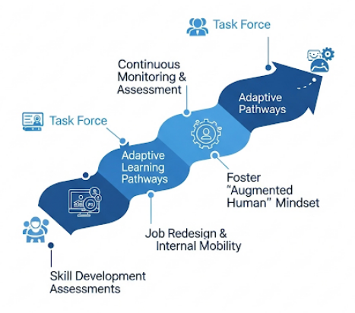
Proactive Workforce Transformation
Notes:
Establish "Future of Work" Task Force comprised of HR, WOP, IT, and Business Unit Leaders.
They would oversee or direct in 4 key areas…
Continuous Monitoring of AI/automation trends, and conduct regular assessments of task-level impact on roles, and future skill needs.
Offer Adaptive Learning Pathways: deploying modular, agile, focusing on critical skills (adaptability, data analysis, AI literacy). Prioritize online courses & on-the-job training.
Perform Job Redesign & Internal Mobility: proactively transitioning employees from declining to growing roles.
To foster the "Augmented Human" mindset, employees should be trained to work with AI to enhance capabilities (higher-order cognition, creativity, interpersonal interactions).

Slide 12

Transparent Communication & Growth Mindset
Communication
Culture
Transparency
Notes:
My second strategic recommendation involves 3 leadership specific champion opportunities…
1. A Comprehensive AI Communication Strategy: Transparent, proactive articulation of why AI is adopted, benefits, and employee impact, proactively addressing job displacement concerns directly.
2. To Cultivate Continuous Learning Culture: Making "growth mindset" a core value, with recognition/rewards for employees embracing new tech and/or skills.
3. Leadership Transparency: Train leaders to be open about AI challenges/opportunities, solicit feedback, and involve employees in adoption.

Slide 13
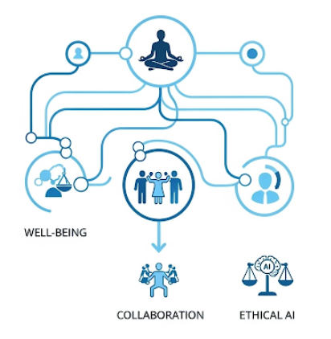
Redefine Structure & Leadership for Human-Centered Future
Notes:
A third recommendation for a firm would be to Redefine Structure (Org Culture) & Leadership for a Human-Centered Future by,
Optimizing Hybrid/Remote Work Models: Invest in collaboration technology, develop leadership competencies for distributed teams, ensure equitable experiences.
Integrating Employee Well-being: This being a strategic business imperative. Implement mental/physical health programs, flexible workplace arrangements, and wellness resources. Leaders must champion well-being.
Embrace Networked & Collaborative Structures: Shift from rigid hierarchies to agile, responsive models; foster interdisciplinary collaboration.
Human-Centered AI Design: Actively involve those WOP experts in AI system design/deployment; prioritize human-centered principles, address transparency/accountability.

Slide 14

A Roadmap for The Future
Bridge the “Perception Gap”
Broader Mixed- Method Studies
Interdisciplinary Frameworks
Notes:
Though my study was comprehensive, it still has limitations, and no study would be complete without offering room for improvement.
Those opportunities include
Bridging the "Perception Gap": Investigating public vs. expert views on AI and developing effective public education strategies.
Broader Mixed-Method Studies: Across diverse organizations, industries, and regions to enhance widespread use.
Developing Interdisciplinary Frameworks: to test human-AI collaboration frameworks involving those WOP experts in early AI system design.

Slide 15

Thank You!
Notes:
In closing, I walked away from this project with a better understanding of recent strategic decisions that have impacted my role at work, and I can also explain them more effectively to my team members.
Questions?
Thank you!

